Slide 1
The Prediction of PTSD and Dropout Rates in IDF Using Machine Learning

Slide 2
The Current Sample
Original data – 1103 subjects, 3 time points
Number of subjects without PTSD - 681
Number of subjects with PTSD - 44
8% PTSD rate
Number of subjects who didn’t dropout - 978
Number of subjects who Dropout - 125
11% dropout rate

Slide 3
Features
Single time sample features:
Genome data
Combat exposure data
Demographics
Time dependent features:
Coping mechanisms
Psychological inventories
- Computerized dot probe data

Slide 4
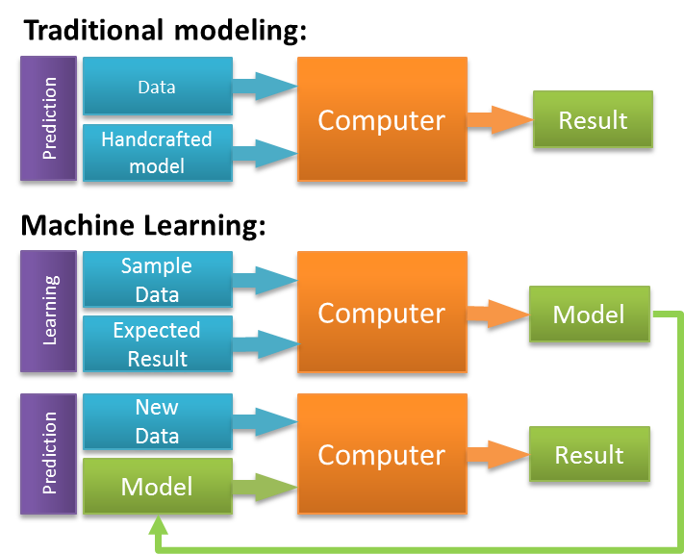
Machine learning
Machine learning is the science of programming computers so they can learn from the data itself.
Machine learning is applied to building models of the data.
These models have tunable inner parameters that can be optimized to fit the data.
Once these models are created, they can be used to predict new data.
In supervised learning the training data includes the desired solution
The models learn to fit the data to it’s label.

Slide 5
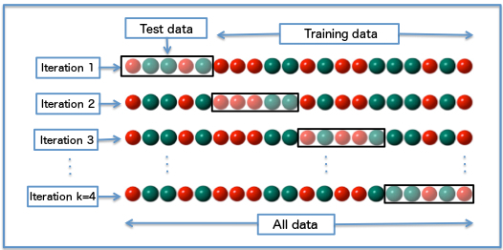
Project Pipeline
Split data to training, holdout & test set
Imputing missing data
Scaling features
Using under-sampling algorithm
Training the model
Get cross validation scores
Get holdout scores

Slide 6
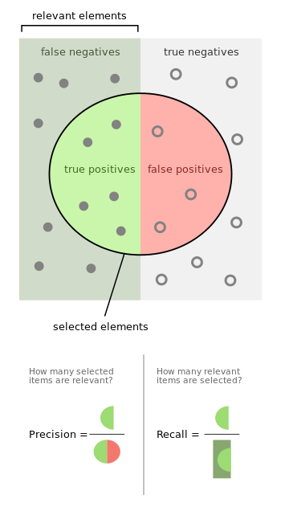

Model evaluation

Slide 7
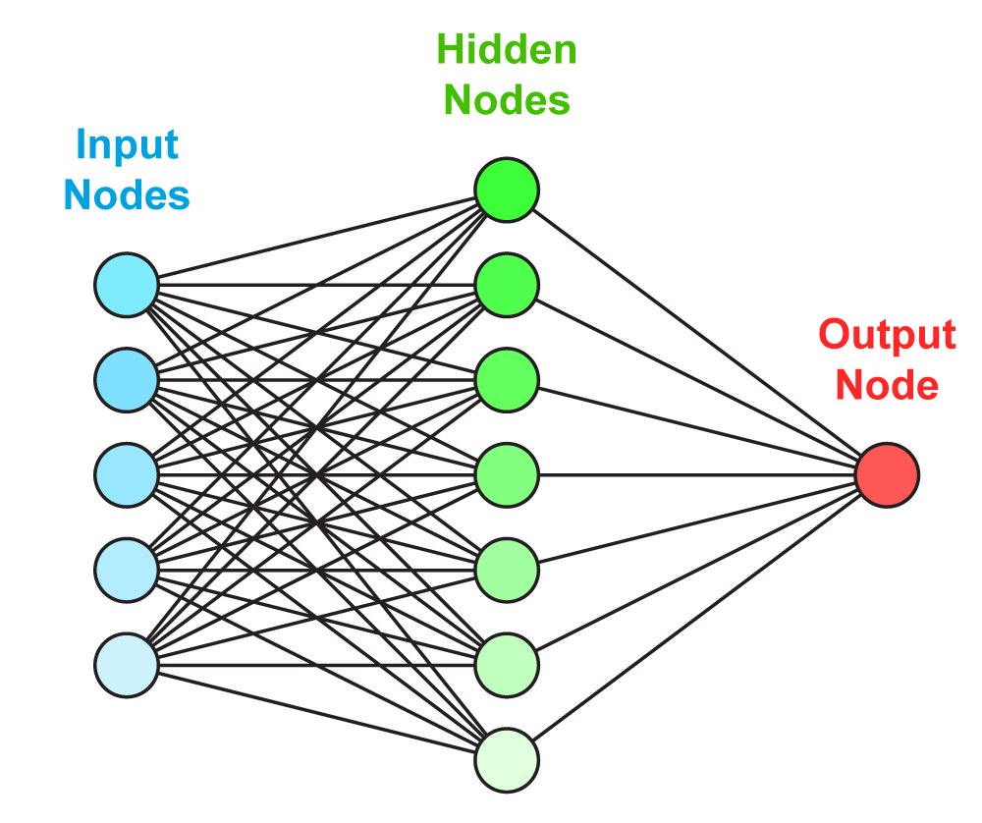
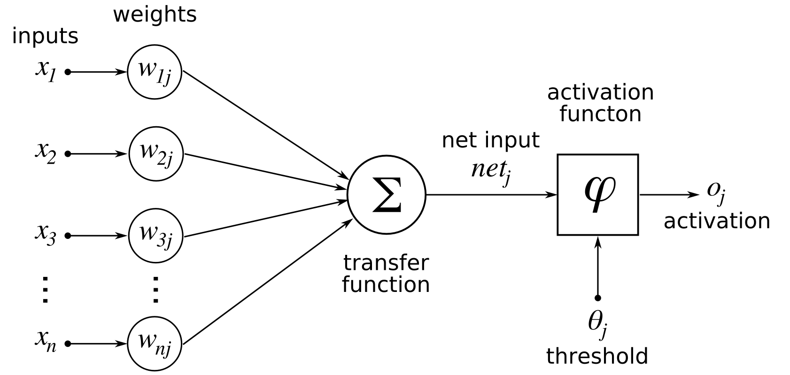
Neural Network

Slide 8
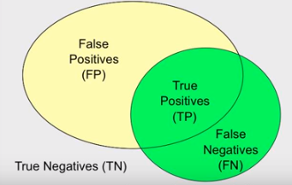
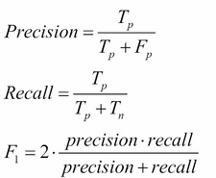
Results
Cross Validation Results –
F1 – 38% precision – 35.6% Recall – 41.67%
Holdout Set Results
F1 Score – 44.45%
Precision Score – 40%
Recall Score – 50%

Slide 9
Dropout detection

Slide 10
Pipeline
Splitting data to training, holdout & test set
1
Imputing missing data
2
Using Over- sampling algorithm
3
Transforming the data using PCA
4
Training the model
5
Get cross validation scores
6
Getting holdout scores
7
Using only time-1 features & time independent features

Slide 11
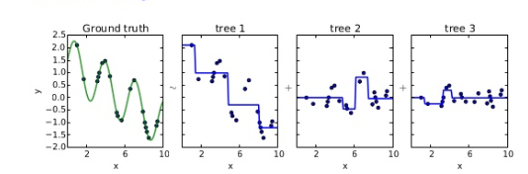
Gradient Boosting
Learn sequence of predictors
Sum of predictions is increasingly accurate
Predictive function is increasingly complex

Slide 12
Results
Cross Validation Results – Precision- 66.8%
Using threshold of 80%
Precision Score -80%
Recall score – 72%
F1 Score – 76%
Holdout Set
n = 100
11 dropped
Predicted – 10
Wrong - 2

